Slide 1




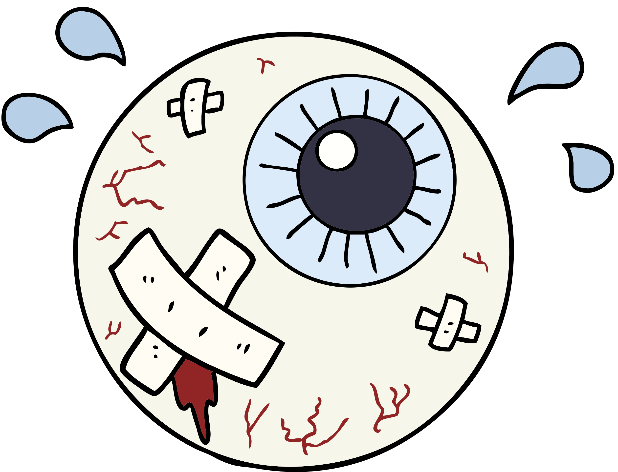
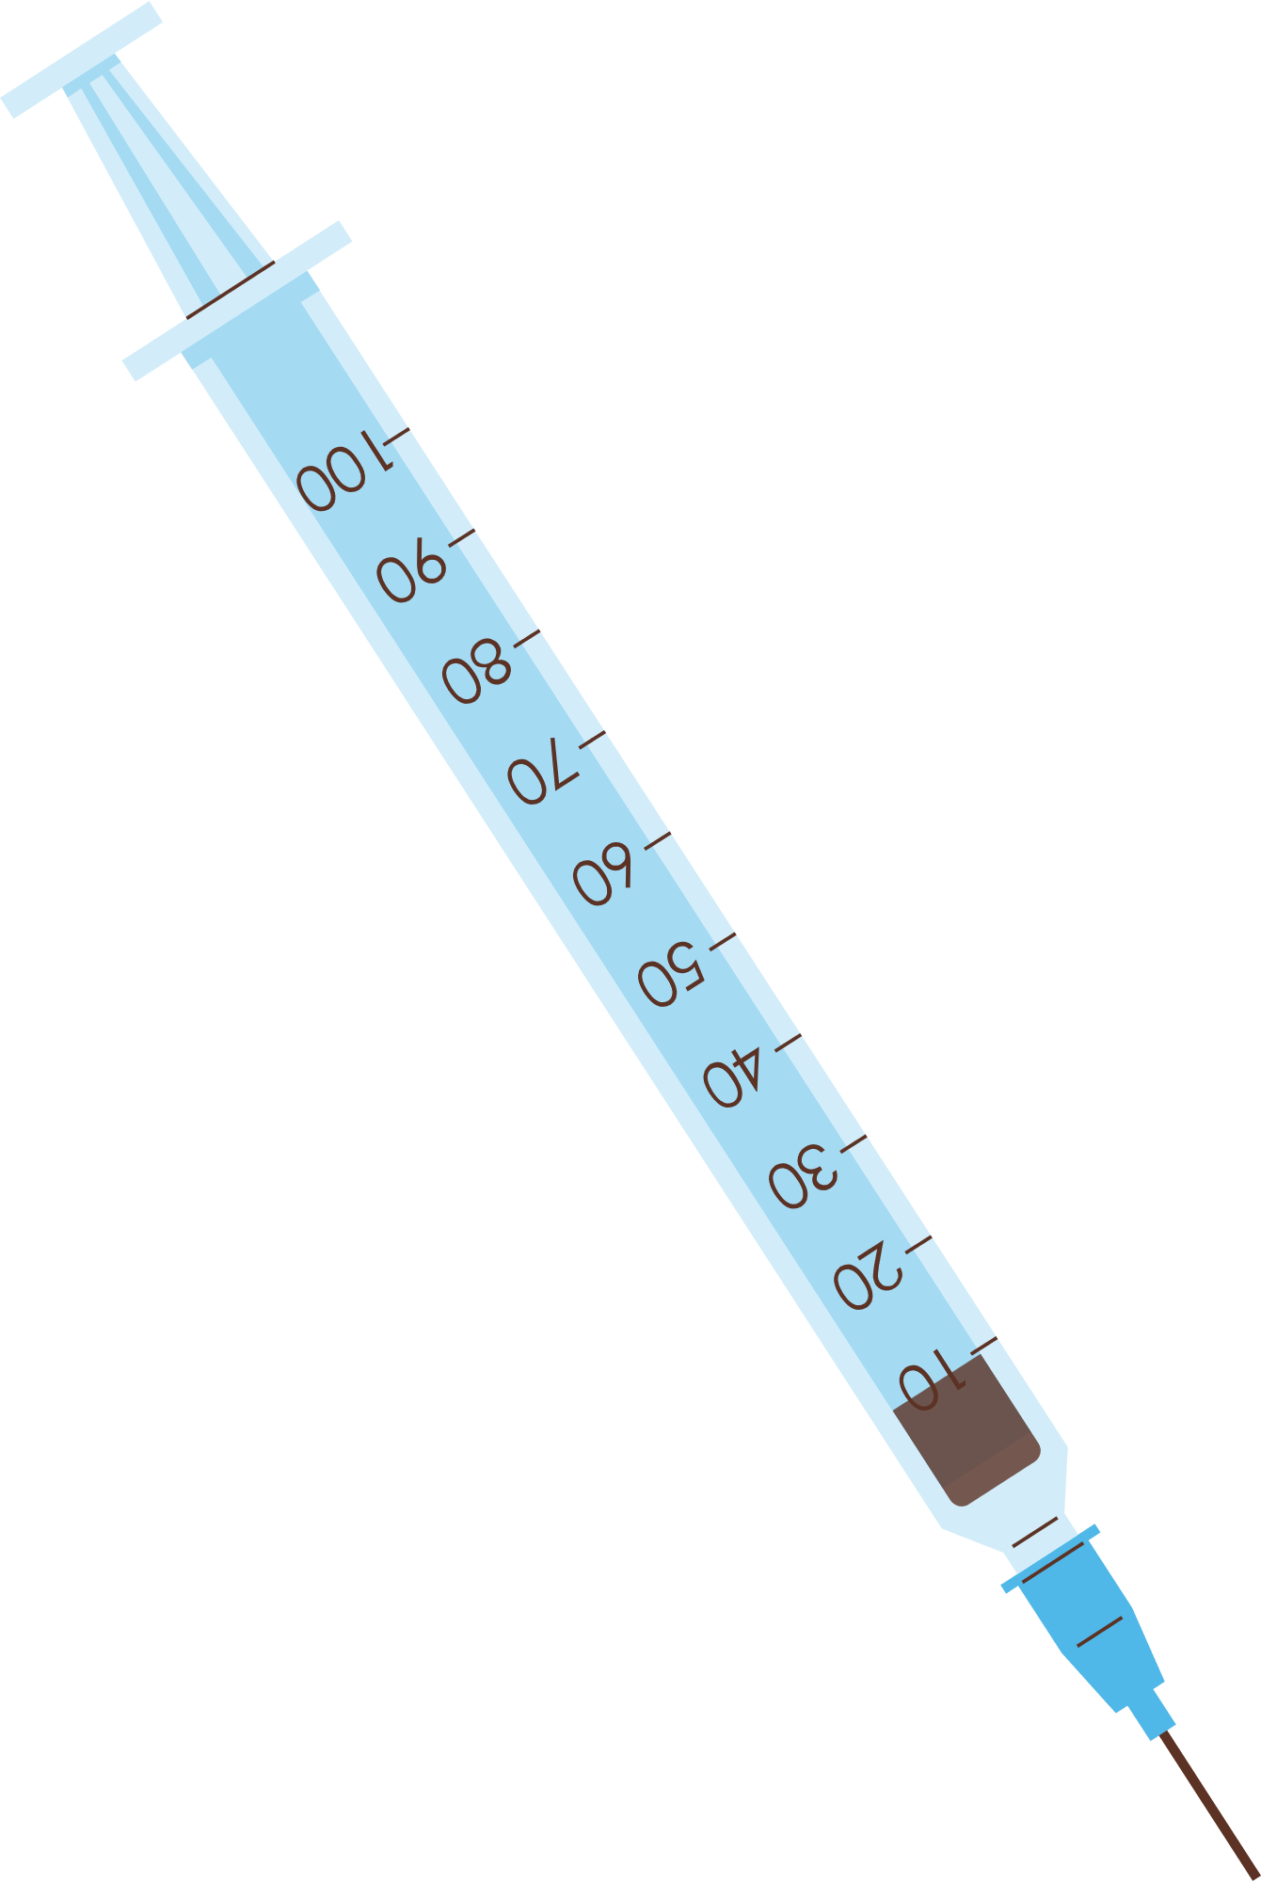



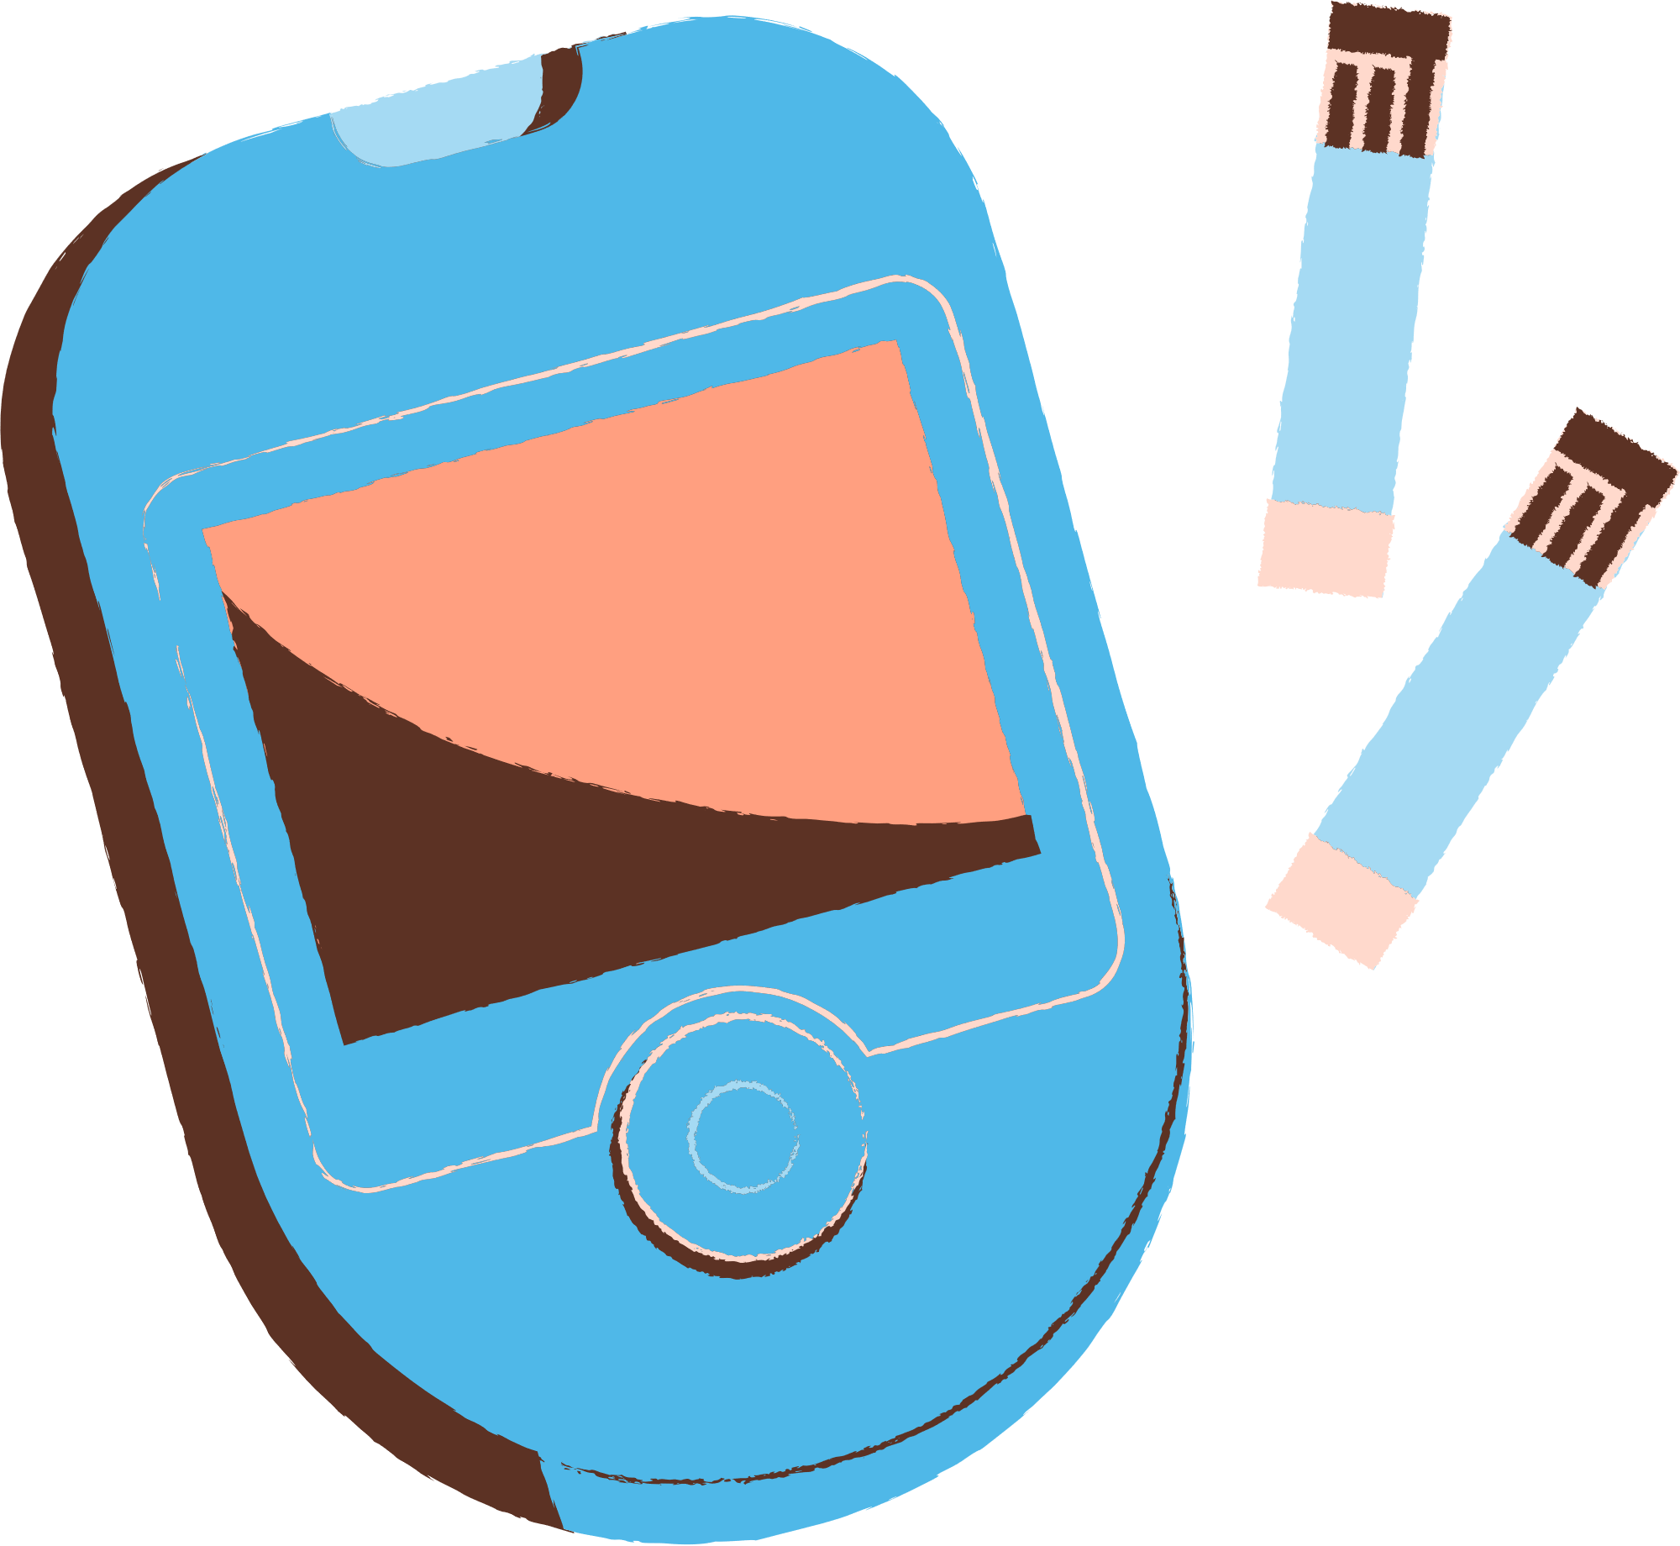
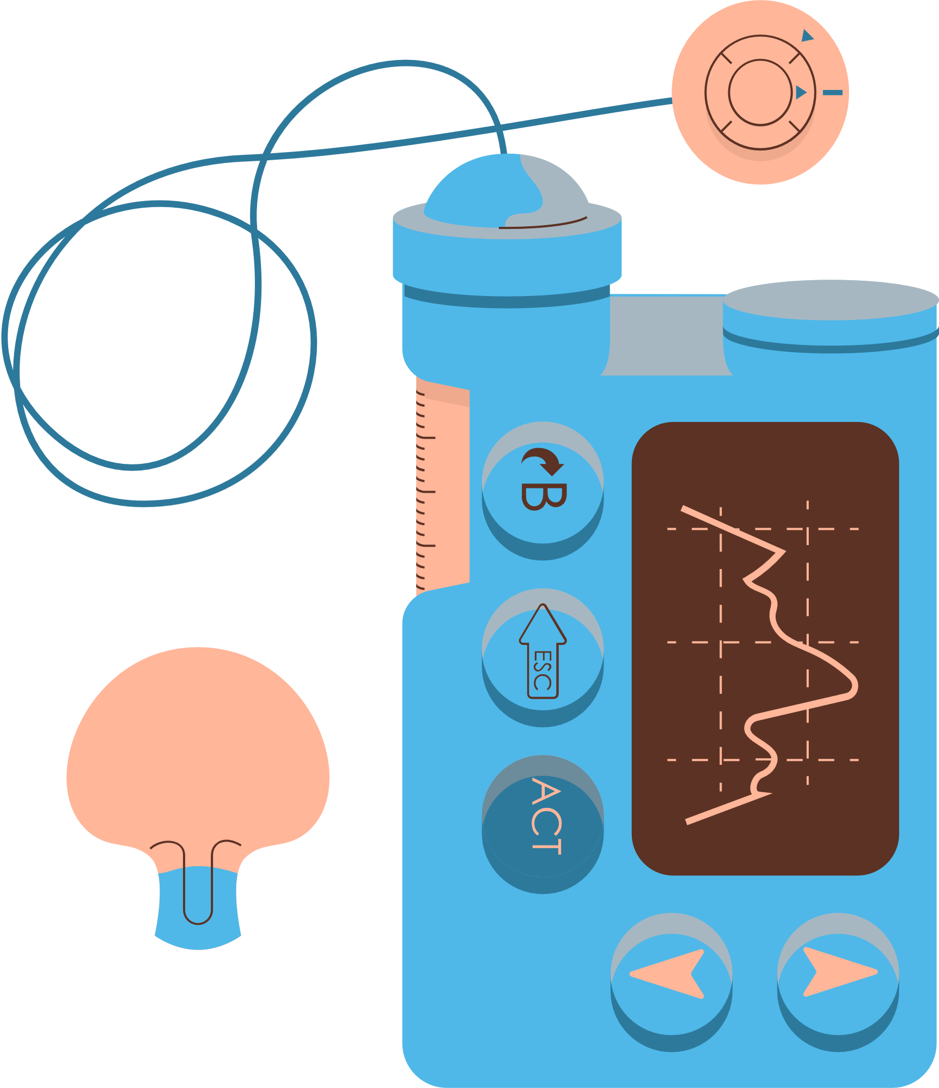
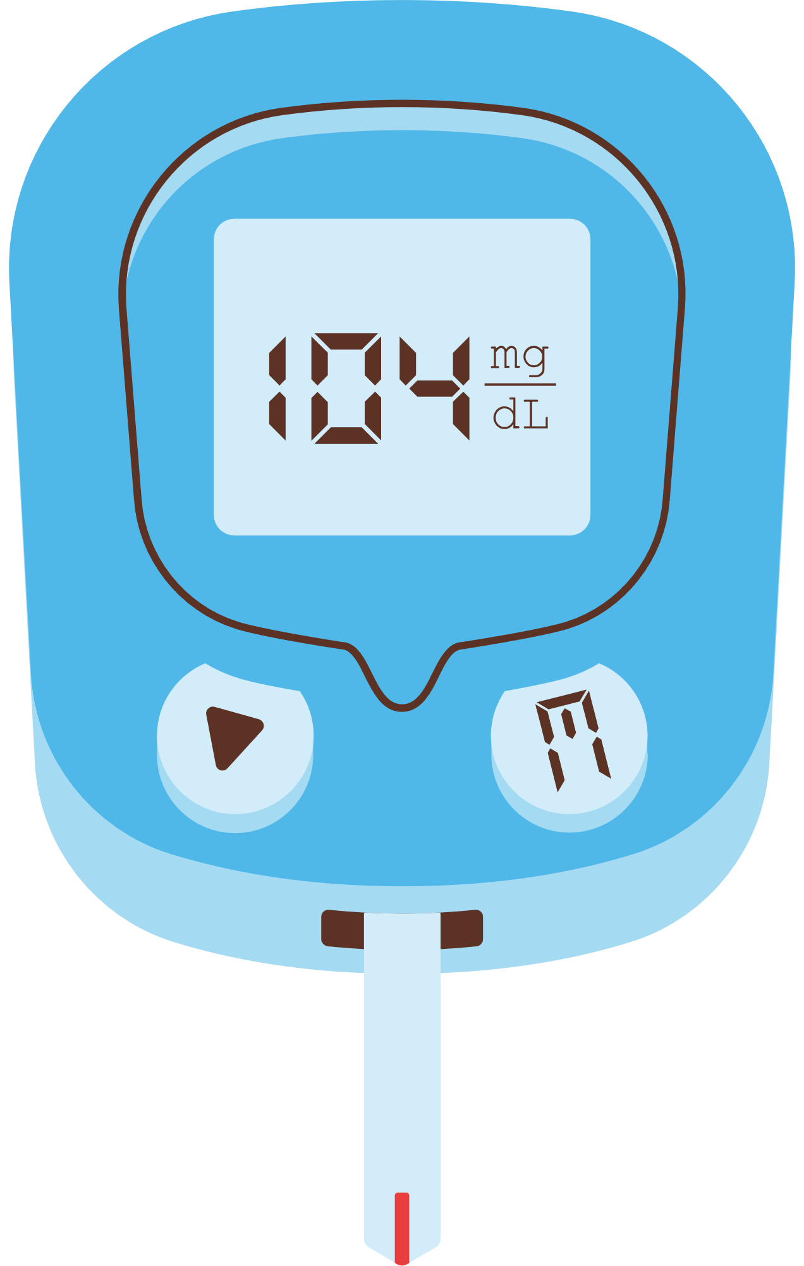


NAVIGATING THE PATHWAY OF DIABETIC RETINOPATHY: TRIALS AND TRIUMPHS AND THE VISION OF THE FUTURE
Dr Rebecca Thomas (Becky) & Bernadette Warren

Slide 2



TODAY'S AGENDA
  What is diabetic retinopathy/maculopathy & why is it important
  Why is screening for diabetic retinopathy important
  How can I stop diabetic retinopathy
  What happens if I get diabetic retinopathy
  What does the future of diabetic retinopathy look like

Slide 3
TRIGGER WARNING
I will be discussing with you today a complication of diabetes and I will be showing photographs of the back of your eye (retina) which some people may find disturbing.

Slide 4

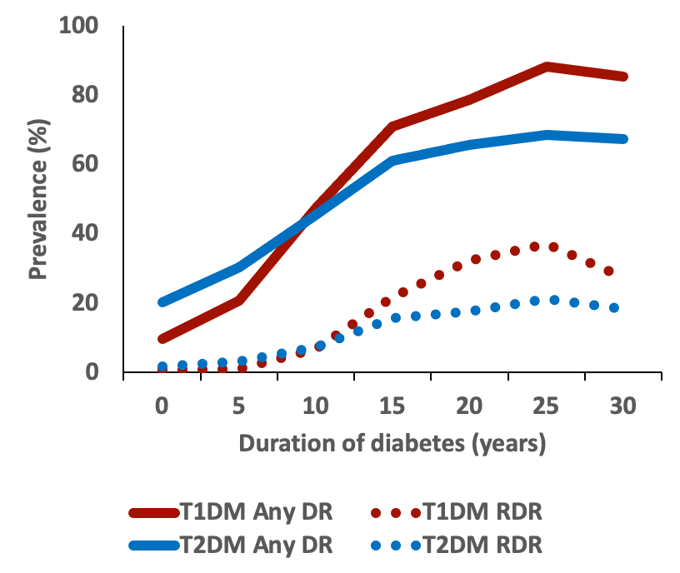
WHY DOES DIABETIC RETINOPATHY DEVELOP
  High blood sugar levels means glucose is circulating in the blood and traveling through your blood vessels and organs
  The longer you have diabetes the more damage glucose in your blood does
Notes:
2 things to mention
The longer you have diabetes for the greater your risk of developing diabetic retinopathy.
This graph can look scary and as if diabetic retinopathy and blindess is inevitable.
But its not
Things in the future may changes with HCL but we'll come to that next

Slide 5
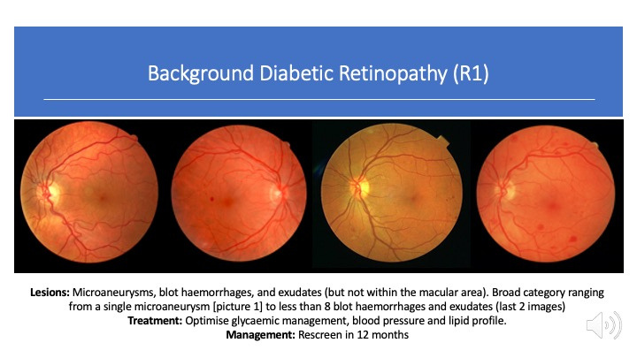
Diabetic retinopathy

Slide 6
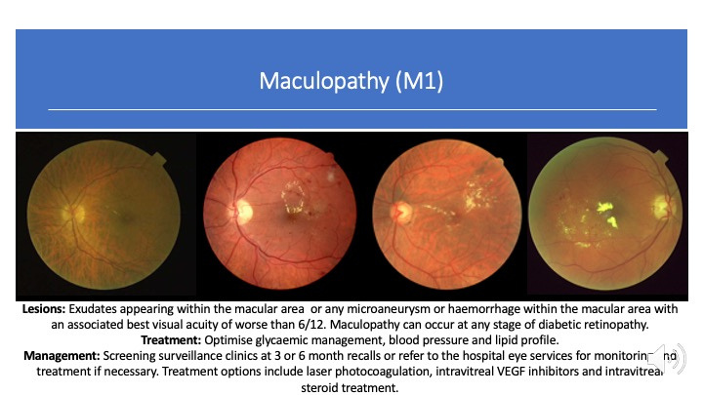
Diabetic Maculopathy

Slide 7
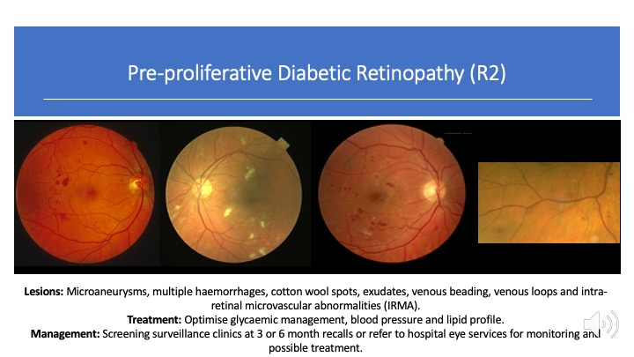
Diabetic retinopathy

Slide 8
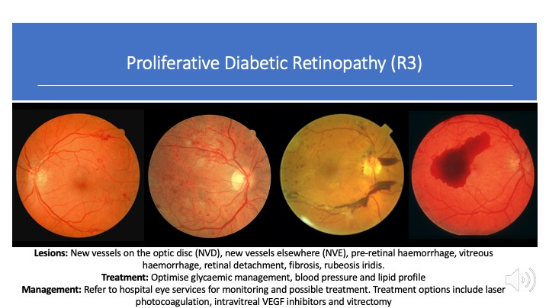
Diabetic retinopathy

Slide 9
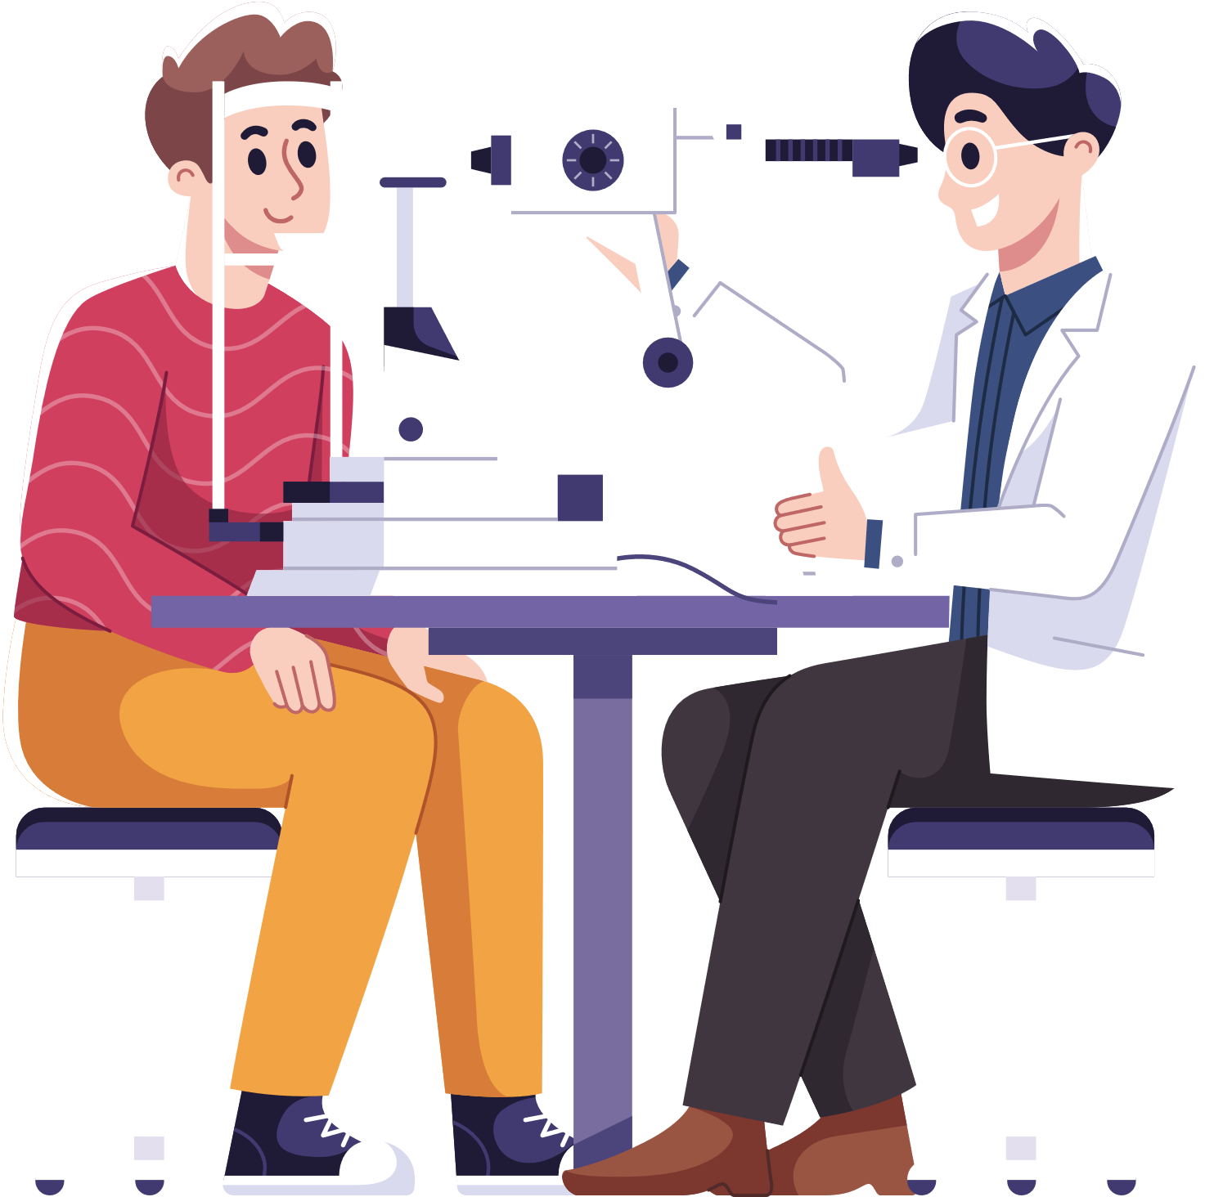

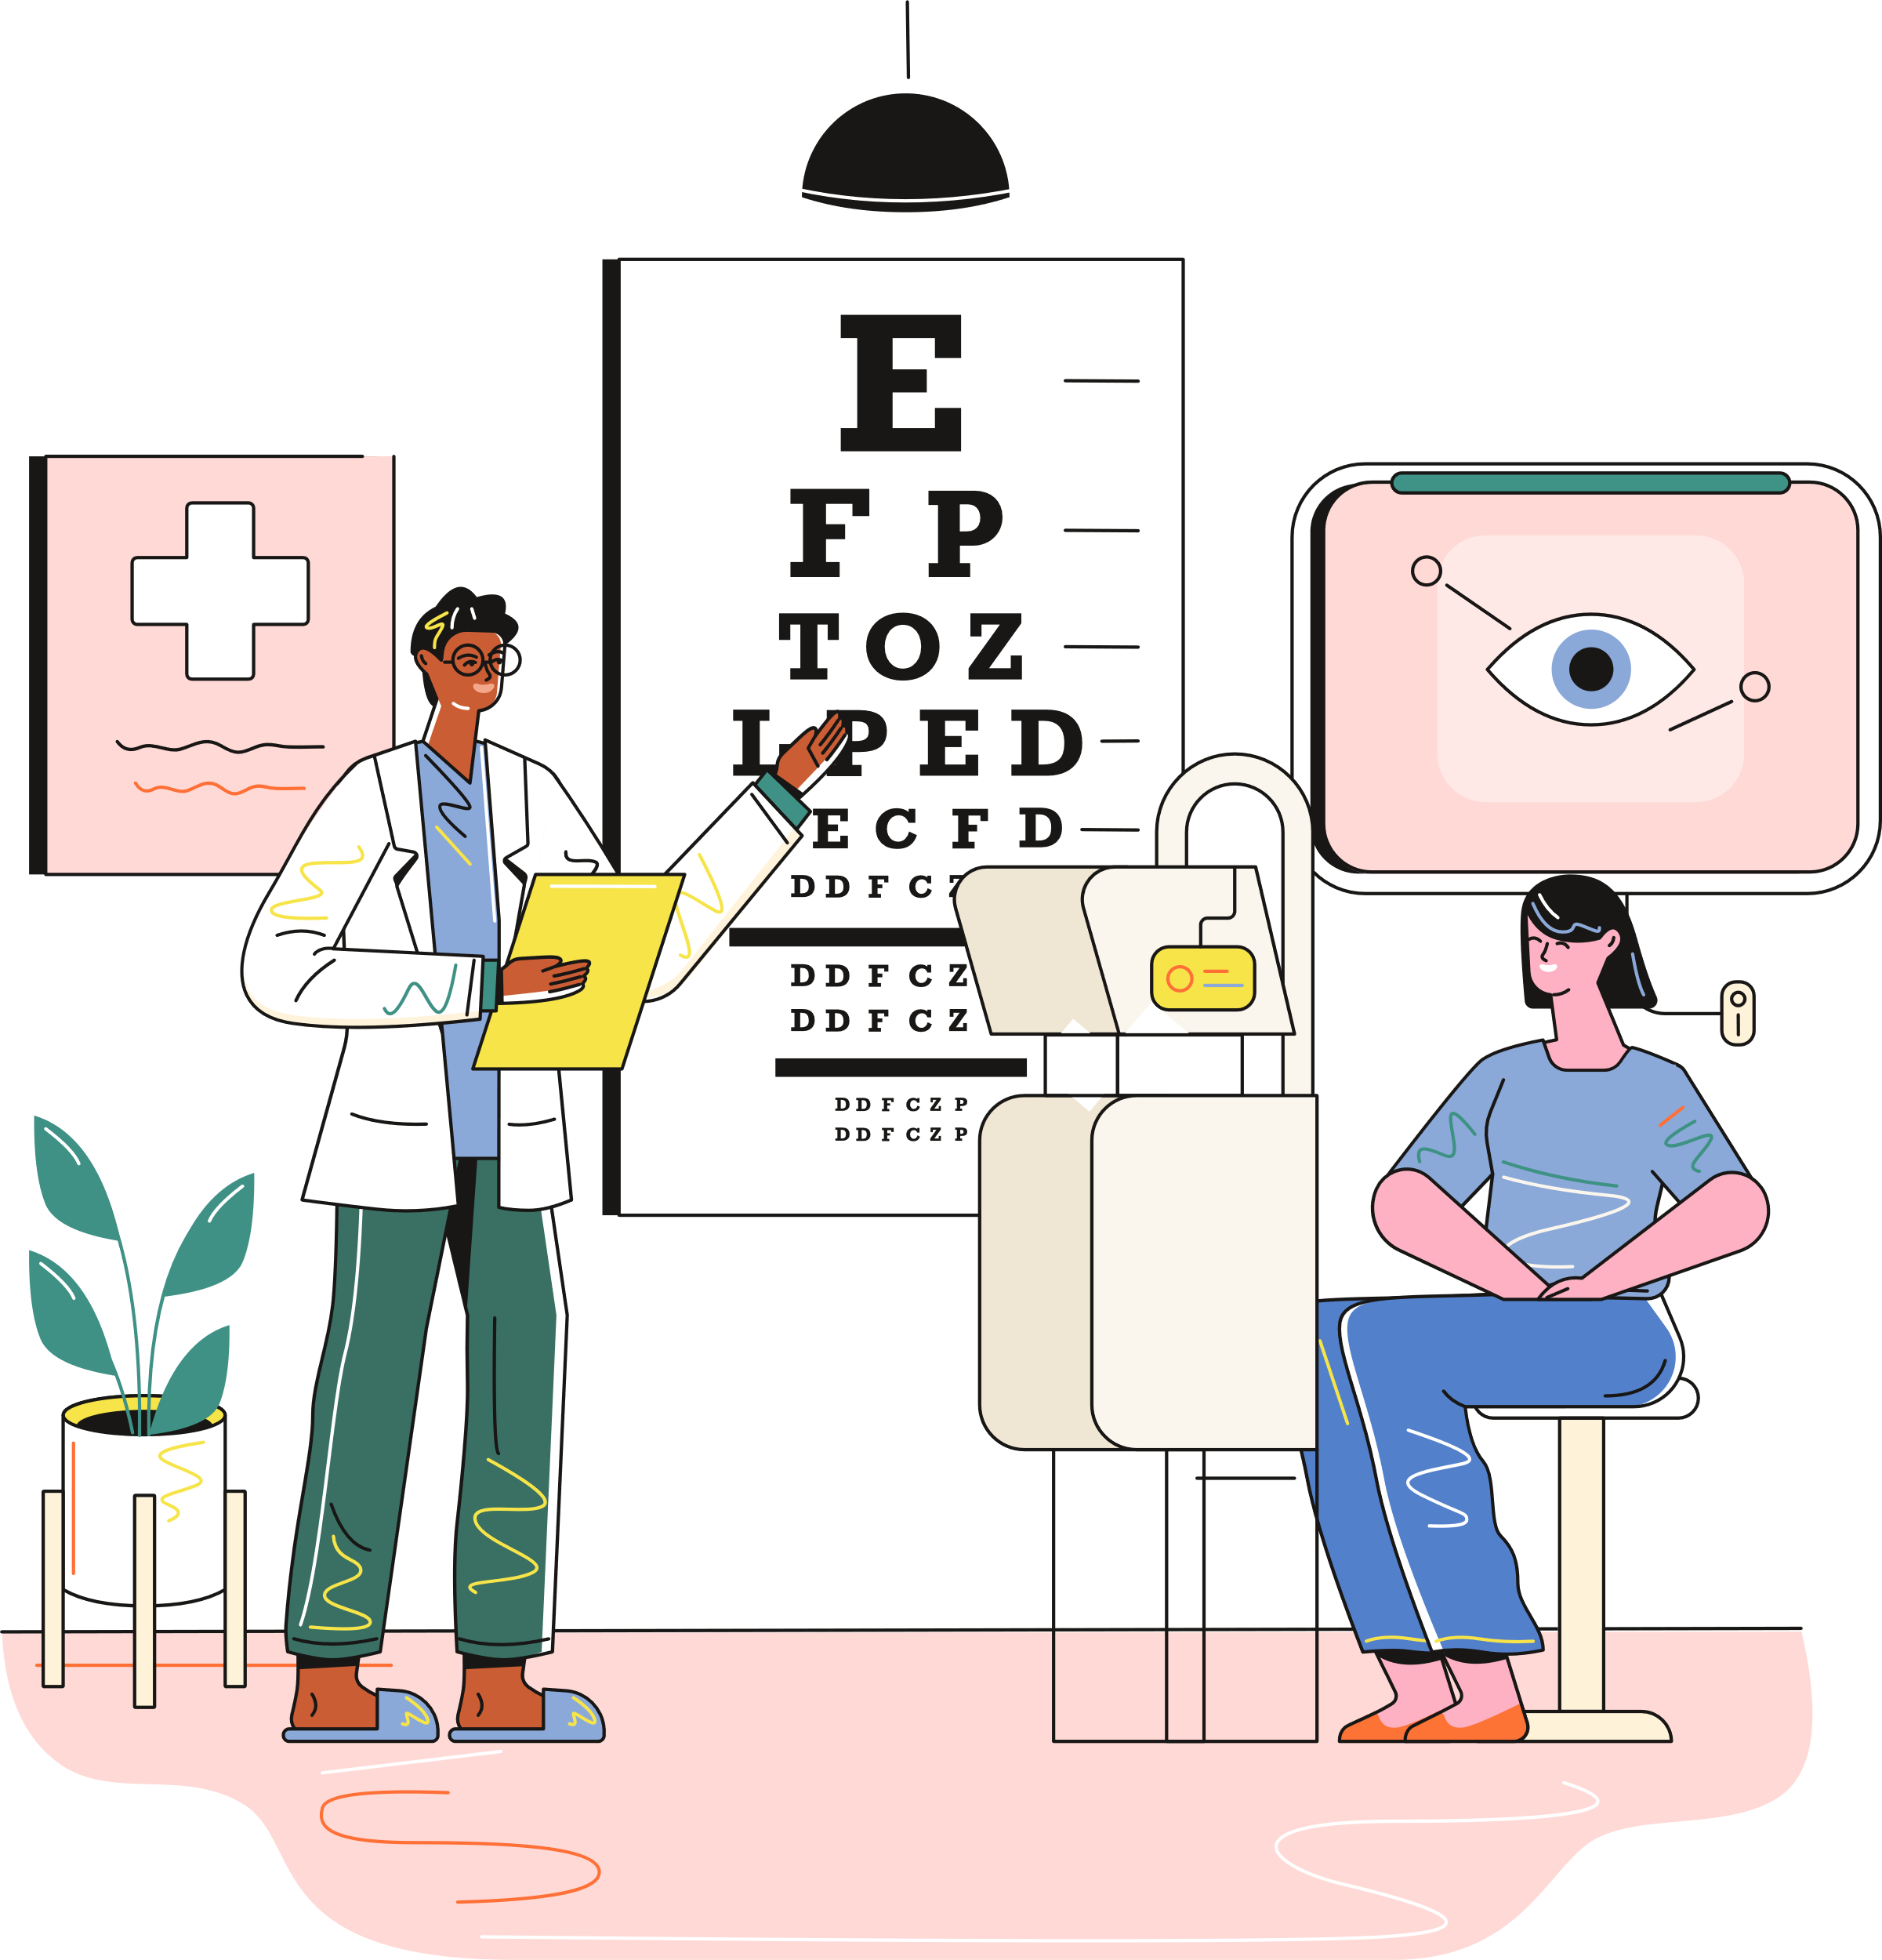
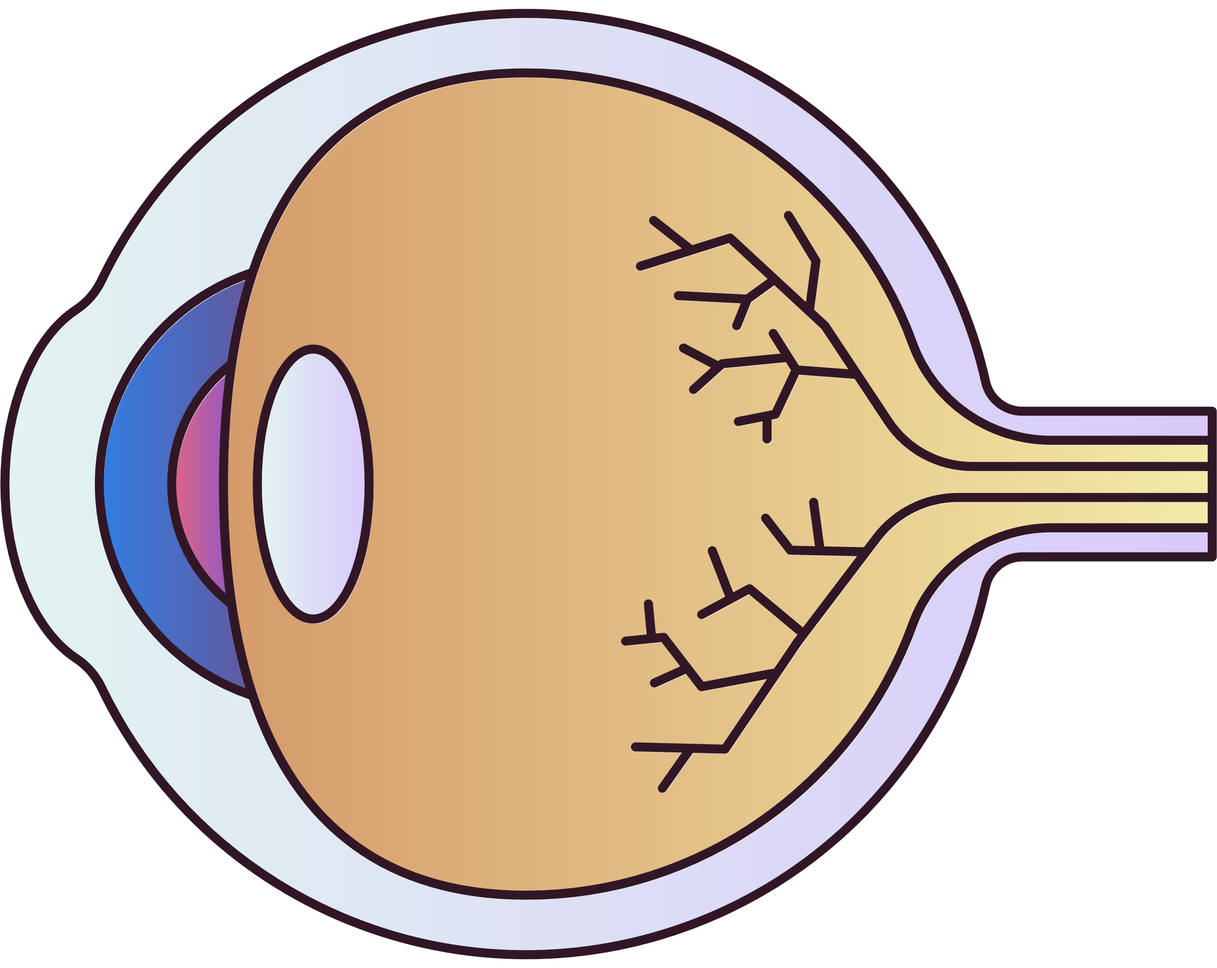
SCREENING FOR DIABETIC RETINOPATHY
  Screening for diabetic retinopathy is important as it looks for changes before there is any damage to your vision
  This is the point when treatment is the most effective and less treatment is required
  Once changes to your vision occur more extensive treatment is needed and the poorer your vision outcome is.

Slide 10


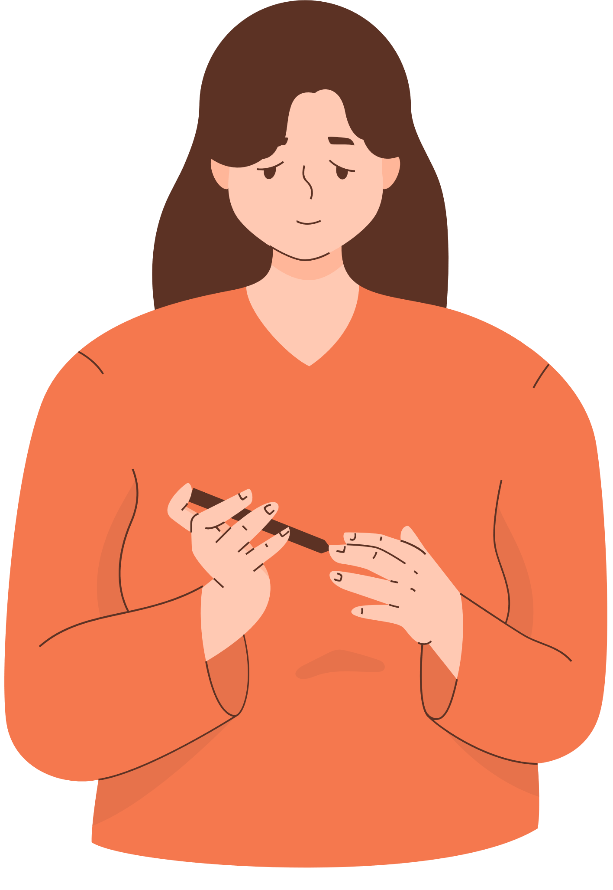

2003
2016
2023
  Screening started in the UK.
  Annual screening due to a lack of evidence.
  Fitted in with other 9 care processes.
  UK National Screening Committee recommended biennial (once every two years) screening in people considered to be low risk.
  2021 Scotland implemented 2 year screening.
  2023 Wales implemented 2 year screening.
  2023-2024 England began roll out.

Slide 11
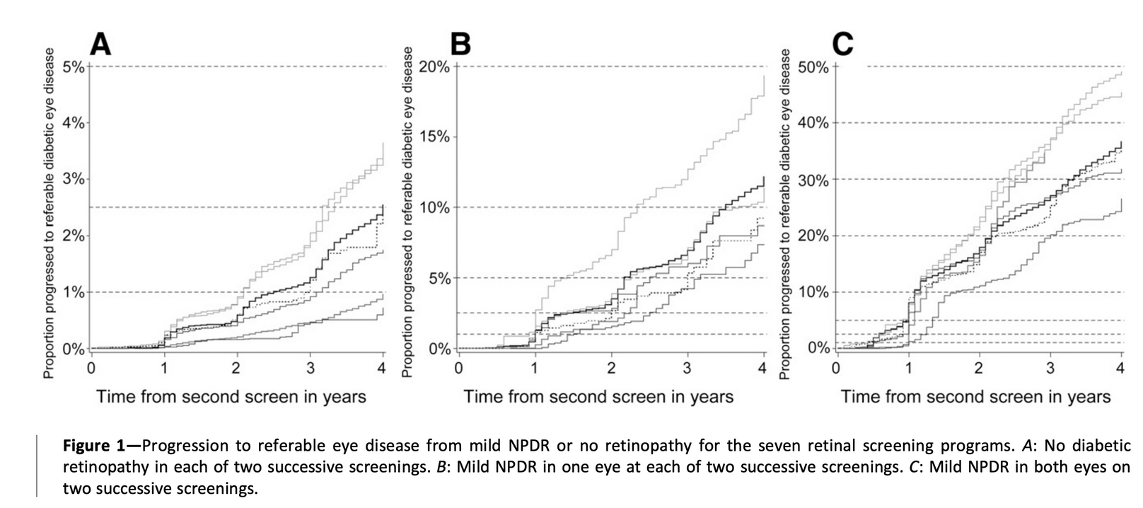
WHY HAVE SCREENING INTERVALS CHANGED?
LEESE ET AL 2015 DIABETES CARE
Notes:
Since screening started in 2003 we’ve been collecting data to look at how frequently we should be screening.
These figures are from 7 screening programmes across the UK.
Figure A is for those without retinopathy at 2 screening intervals and the level of progression to Referrable retinopathy of the next 4 years. At one year the risk was between 0.1 and 0.6% at four years it is 0.6 to 3.6%.
Figure B is for those with mild NPDR in 1 eye at 2 screening intervals. The risk of developing referrable DR at 1 year is 0.9-5% and at 4 years increased to 7.6-17.7%.
Figure C is for those with mild NPDR in both eyes at 2 screenings. The risk of developing referrable DR at 1 year was between 8.3-15.4% and at year 4 was 20.6% - 46.3%.

Slide 12
WHY HAVE SCREENING INTERVALS CHANGED?
  In other countries:
  Iceland introduced biennial screening in 1994
  10 year results reported in 2007 - No one developed sight threatening diabetic retinopathy before developing background retinopathy and being put back to annual screening first

Slide 13





WHO WILL THE CHANGE AFFECT?
  Those people considered to be low risk.
  Low risk are those people without evidence of diabetic retinopathy (R0M0) at 2 screening events
12 Months
24 Months
Screening 1 No Diabetic Retinopathy
Screening 2 No Diabetic Retinopathy
Screening 3

Slide 14


WHO WILL THE CHANGE AFFECT?
  Once you develop background diabetic retinopathy you will be place on an annual recall.
  If you miss your screening appointment you will be recalled in 12 months
  If your diabetes team are concerned about any changes that may affect your eyes they can request an earlier recall.

Slide 15
WHY HAVE SCREENING INTERVALS CHANGED?
  Further changes are under investigation including more personalised screening intervals based on your risk factors as well as retinal status
    HbA1c
    Type of diabetes
    Duration of diabetes
    Blood pressure

Slide 16
Things I can change
Things I can’t change
  High blood glucose
  High blood pressure
  High cholesterol
  Duration of diabetes
  Ethnicity
  Puberty
  Pregnancy
  Genes
Notes:
every 1% (11mmol/mol)reduction in HbA1c means a 35% reduction in the risk of developing retinopathy
repeat
repeat

Slide 17
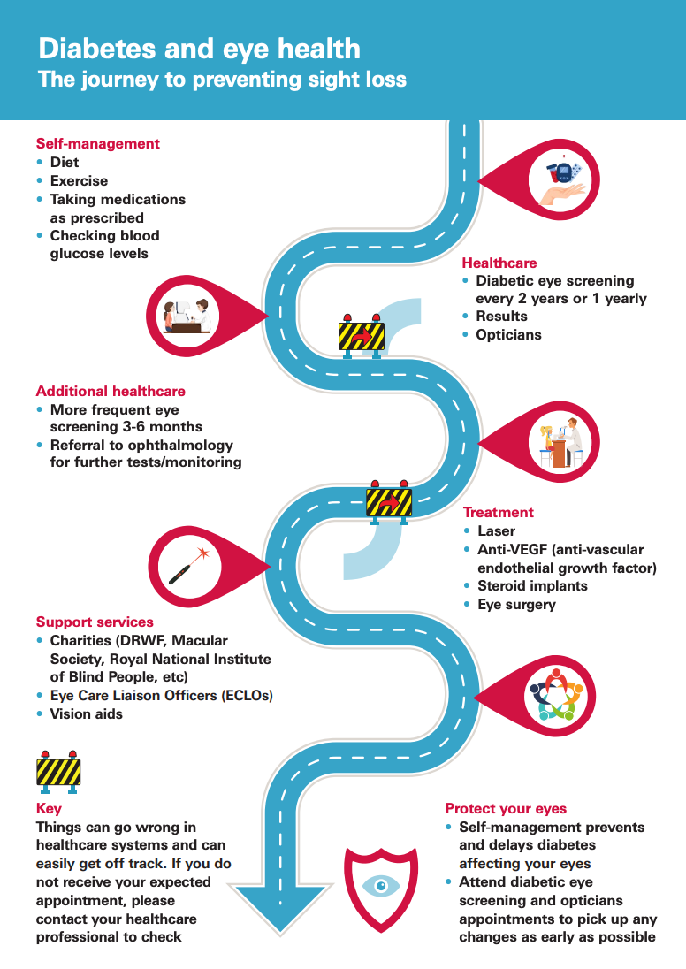
  The new Eye Health and Diabetes leaflet contains a roadmap to preventing sight loss.
  It contains all the stops we’ve just discussed
  Plus a few road blocks for missed appointments either in screening or ophthalmology that can throw you off track.
DRWF Eye Heath and Diabetes Leaflet

Slide 18
DIABETIC RETINOPATHY - FUTURE
  The evidence on the development of diabetic retinopathy is based of UKPDS, DCCT and the Wisonsin epidemiology studies - pre 2000 data
  Since then we have new technology - CGMs and HCL which are available to more people especially in the UK.
  Since CGMs were introduced there was a reduction in the population level average of HbA1c.
Notes:
2 things to mention
The longer you have diabetes for the greater your risk of developing diabetic retinopathy.
This graph can look scary and as if diabetic retinopathy and blindess is inevitable.
But its not
Things in the future may changes with HCL but we'll come to that next

Slide 19
HCL AND DIABETIC RETINOPATHY
  Lowering blood glucose IS good for your eyes
  But evidence suggests lowering blood glucose too quickly could make retinopathy get worse
  What can we do about it?
Notes:
It is true as I've already said lowering HbA1c levels or increasing time in range reduces your risk of developing retinopathy as well as being better for you and your body.
But there is evidence to show that if we do this too fast then retinopathy can get worse.
This evidence does not come from HCL studies as this has yet to be looked at. But it does come from studies of other therapies and circumstances that have seen large reductions in HbA1c like bariatric surgery, starting insulin therapy, pregnancy and starting GLP-1. So it's not caused by the method that reduces the blood glucose levels but from the reduction itself.
There is a lot we do not know about this early worsening of diabetic retinopathy phenomenon. Like how fast is too fast, how big a drop is too much, who is most at risk or even why it happens.
Also in most instances it would be very difficult if not impossible to slow down the speed of change. So what can we do about it?

Slide 20
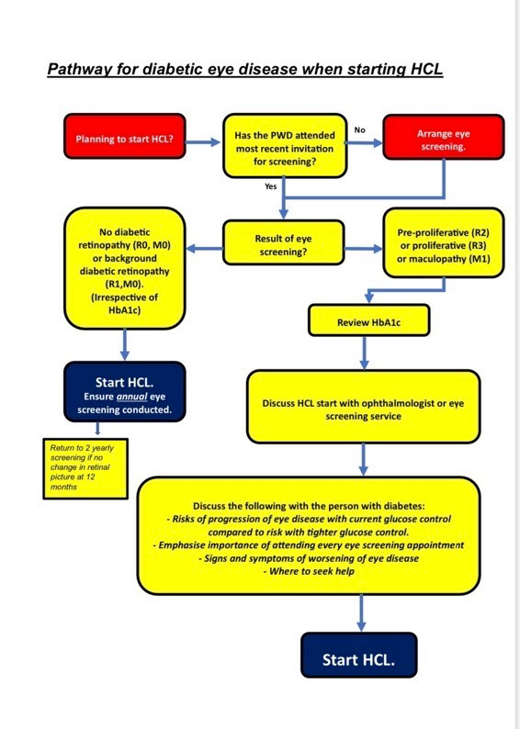
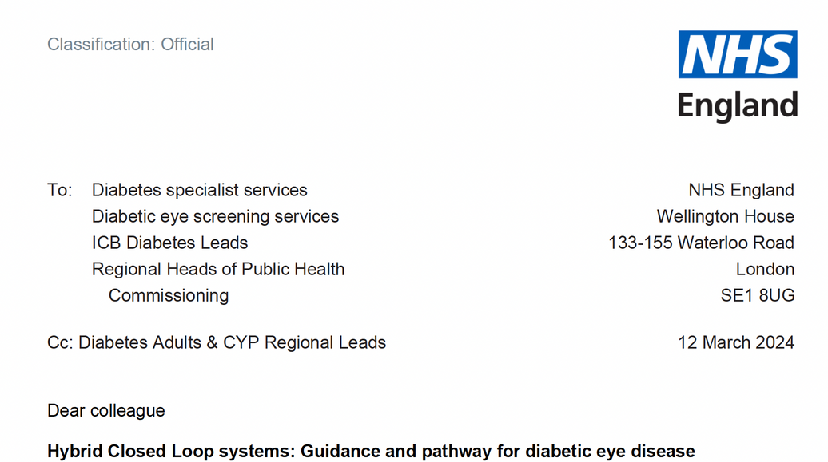
HCL AND DIABETIC RETINOPATHY
Notes:
NHS England has recognised this as an issue and has sent guidance out to all diabetes centres.
They have devised a pathway to help teams decide when to initiate HCL.
It should be remembered that HCL benefits go beyond lower glucose levels and improved time in range to improved quality of life and sleep. People with diabetic retinopathy should still benefit from these and it should not be a barrier to starting HCL. But we do need to be cautious as we must not forget the impact on QOL if sight deteriorates and we need to ensure the person knows the risks they are taking and where to seek help if needed.
So the pathway includes ensure a retinopathy check has been completed recently, if there is pre-proliferative or proliferative retinopathy or maculopathy then there should be a discussion with the ophthalmology team to ensure they can do more frequent monitoring and that a drop in HbA1c isn't going to impact any treatment that may be needed.
Full discussion with the patient around the risks and signs and symptoms should occur and if all agree HCL should start.

Slide 21

DIABETIC RETINOPATHY - FUTURE
In addition to glucose technologies and therapy further reductions in sight loss due to diabetes will require:
  New emerging therapies for diabetic retinopathy
  Reorganising of eyecare services
Notes:
With the benefits of closed loop not just to glycaemic management but also the qol improvements having diabetic retinopathy and the risk of early worsening shouldn't be barrier to this technology.
But equally we can't ignore the potential damage that could be caused to eye sight and the qol consequences of this.
So NHS England have issued a letter to all diabetes centres in England with this pathway. It starts with having an assessment for retinopathy before starting HCL. If this is up to date and there is no retinopathy or background retinopathy the risks are far lower but they suggest people should be on annual screening.
If retinopathy is at a level of pre-proliferative DR proliferative DR or maculopathy then the HbA1c should be reviewed and the HCL start should be discussed with an ophthalmologist. In addition, the risks should be discussed with the patient at the time as well as the signs and symptoms of visual problems as well as where to seek help.
The data will be collected in the National diabetes audit so we can understand more about this problem.

Slide 22

SUMMARY
  Discussing diabetes complications is difficult, but that does not mean we shouldn’t talk about them.
  However, reframing how we discuss complications can help to reduce stigma and increase self management.
  Glycaemic management is the most important way to prevent and delay diabetic retinopathy but it does not mean complications won’t develop.
  Diabetes technology and therapies will change the lanscape of diabetes complications including diabetic retinopathy.
  In addition changes to diabetic retinopathy treatments and organisation of eye care services will help to reduce sight loss from diabetes.

Slide 23
FINAL MESSAGE
  Diabetes and diabetic retinopathy does not mean you will lose vision
  If you do develop diabetic retinopathy or any complication it is not your fault, but there are treatments available to help you.
  The treatments work better when used before vision problems occur

Slide 24
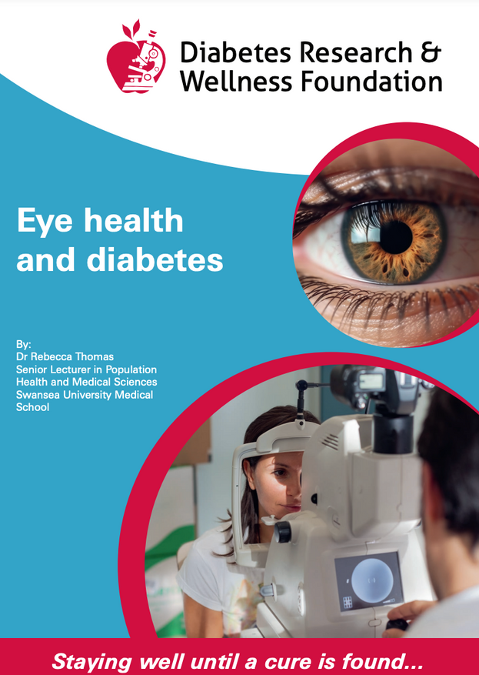

https://www.drwf.org.uk/understanding-diabetes/information-leaflets/

